Slide 1
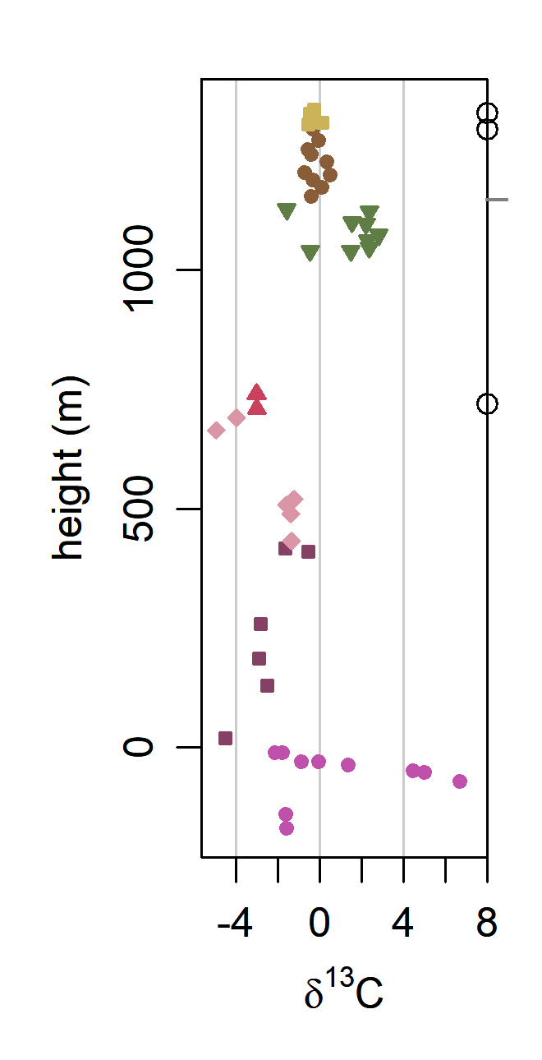
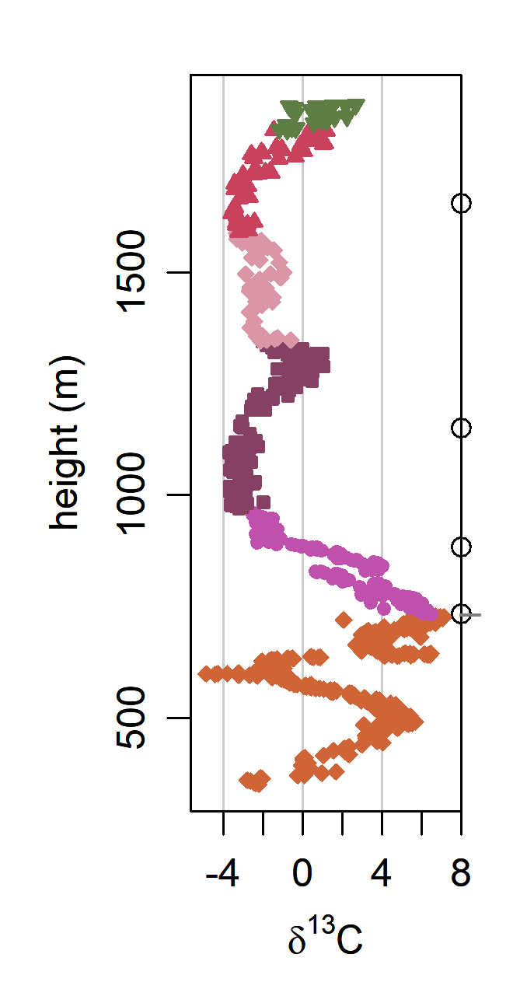
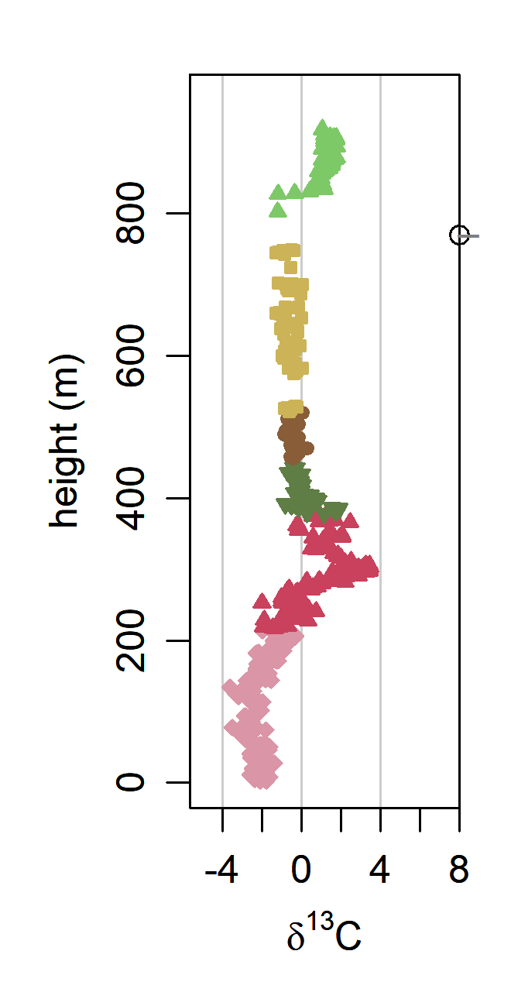
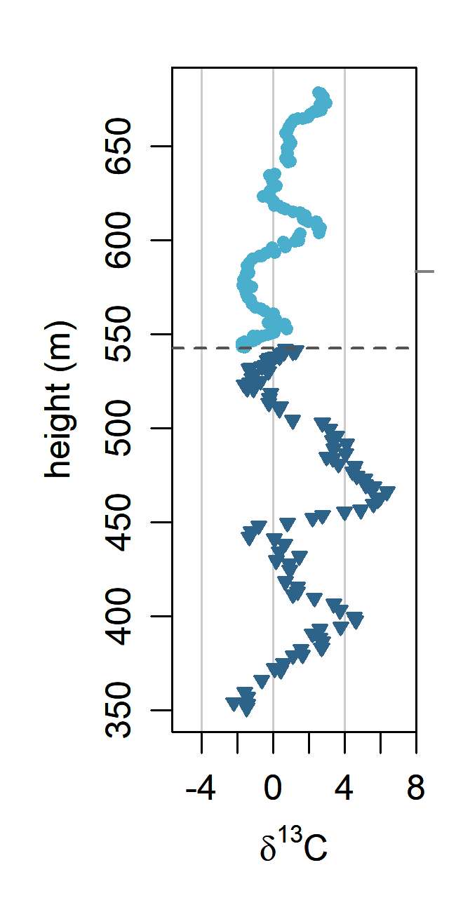
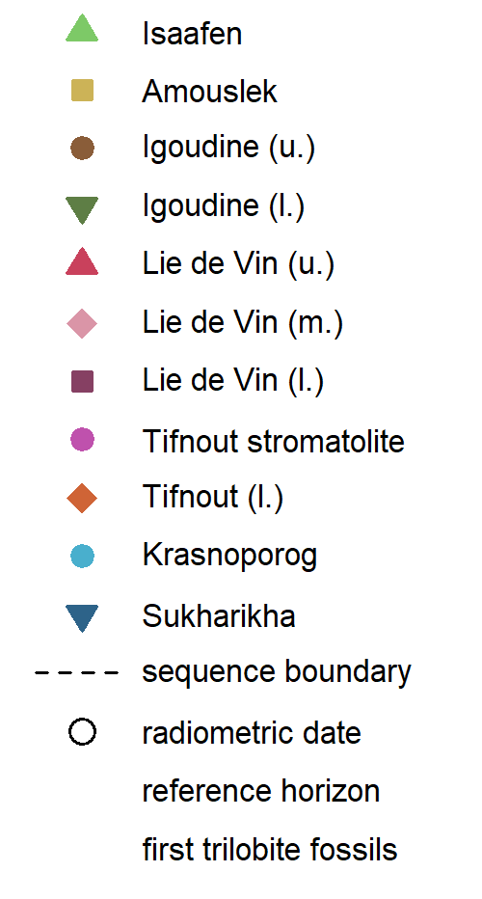
3
(a)
Tiout
(b)
Oued Sdas
(c)
Talat n’Yssi
(d)
Sukharikha
518.99
± 0.14
519.23
± 0.14
α
520.93
± 0.14
5
517
± 1.5
α
370.4663212
260.3626943
219.343696
292.3370603
246.4018423
3
α
1
521.06
± 0.12
4
523.17
± 0.16
2
524.84
± 0.09
525.35
± 0.09
α
α

Slide 2
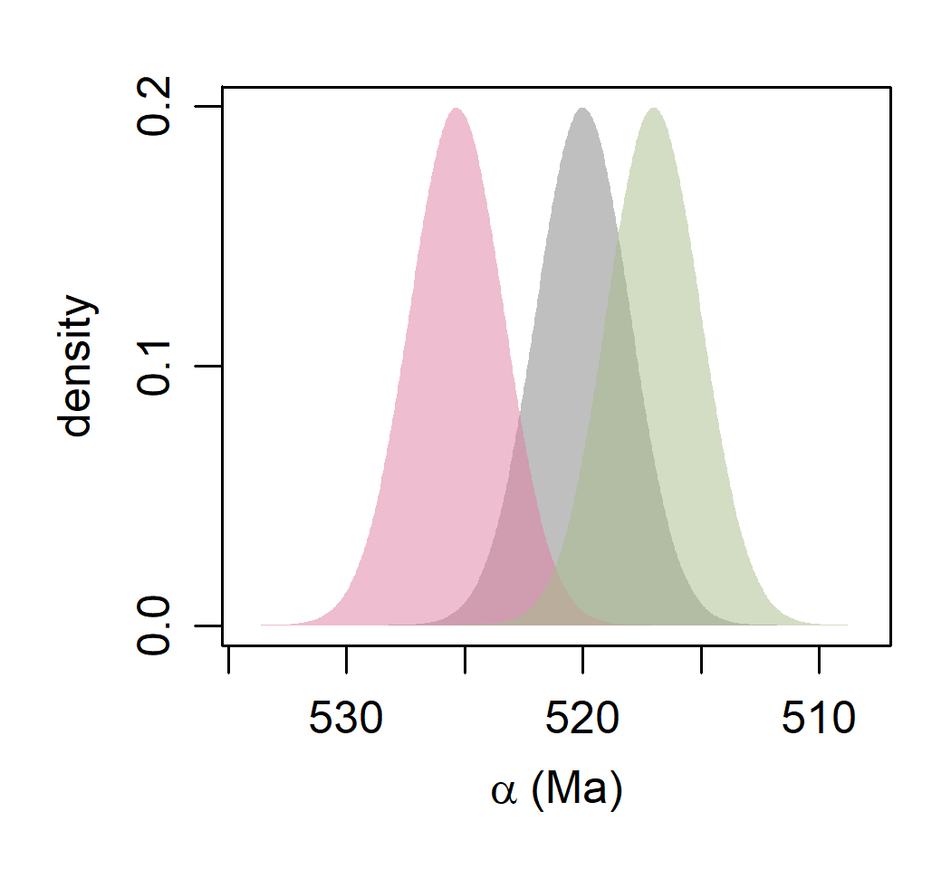
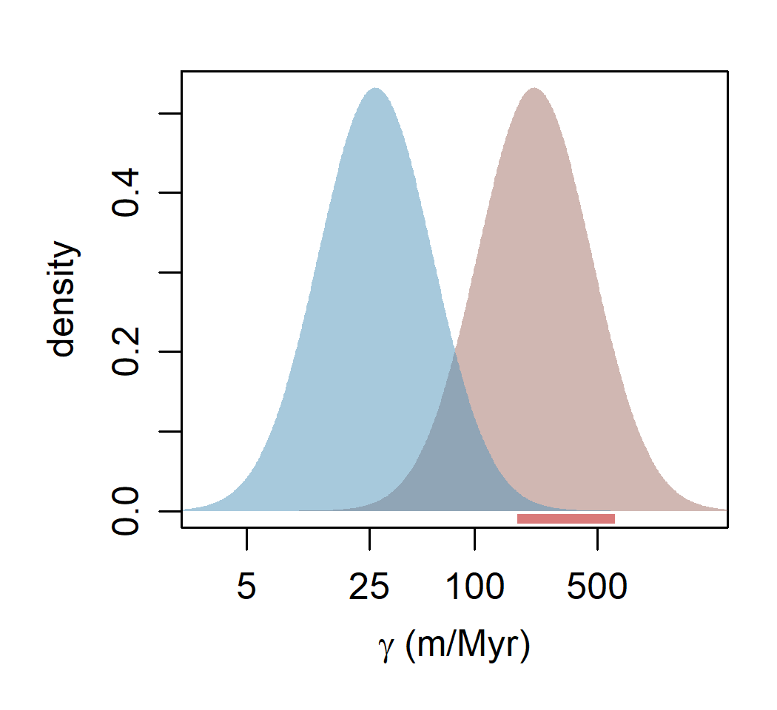
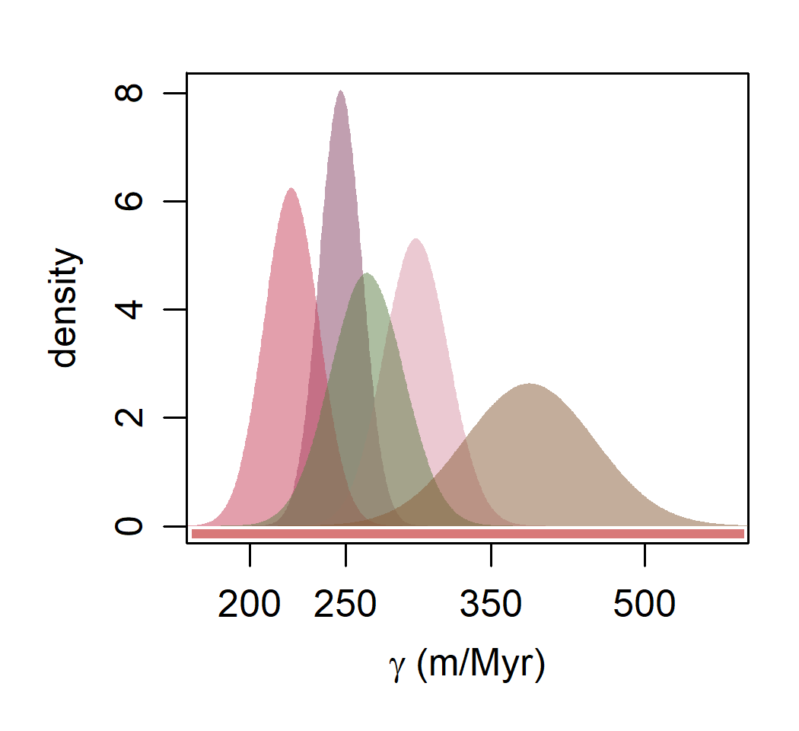
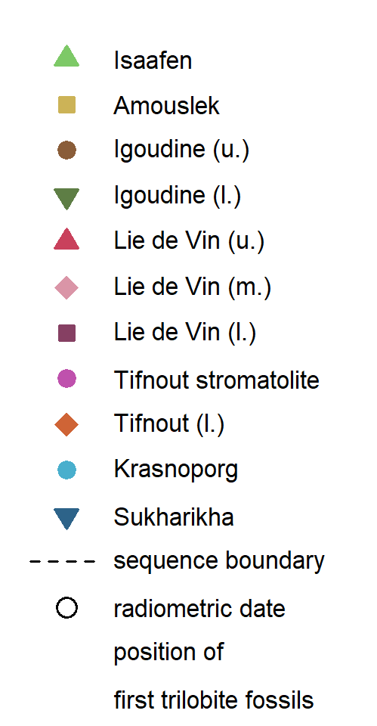
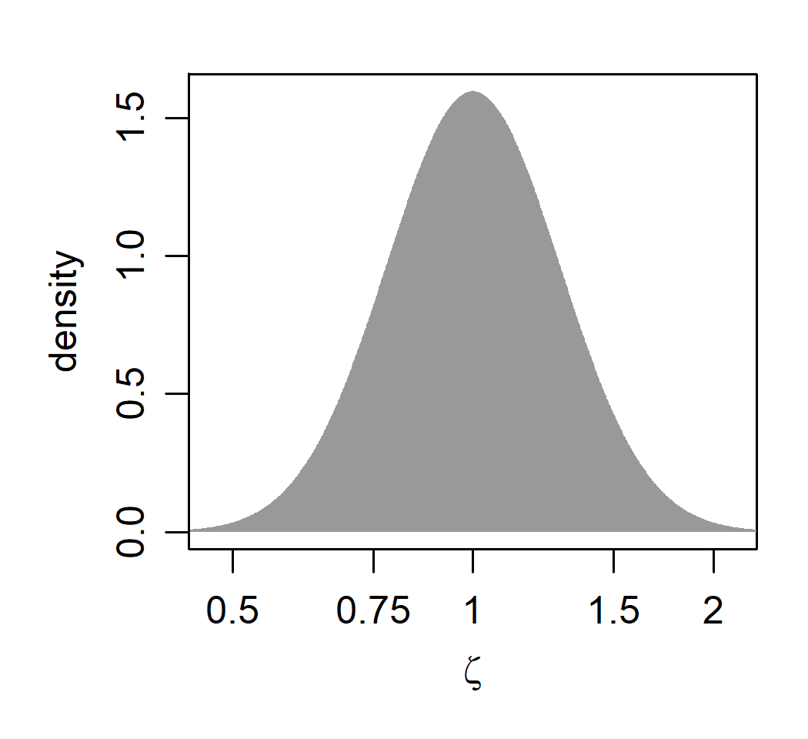
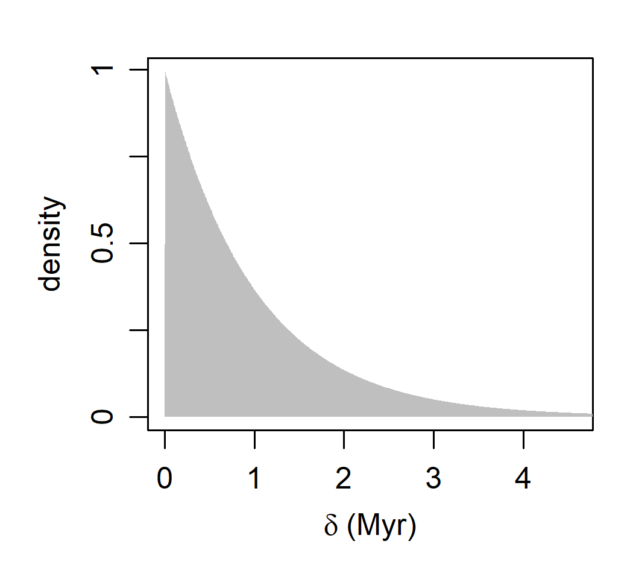
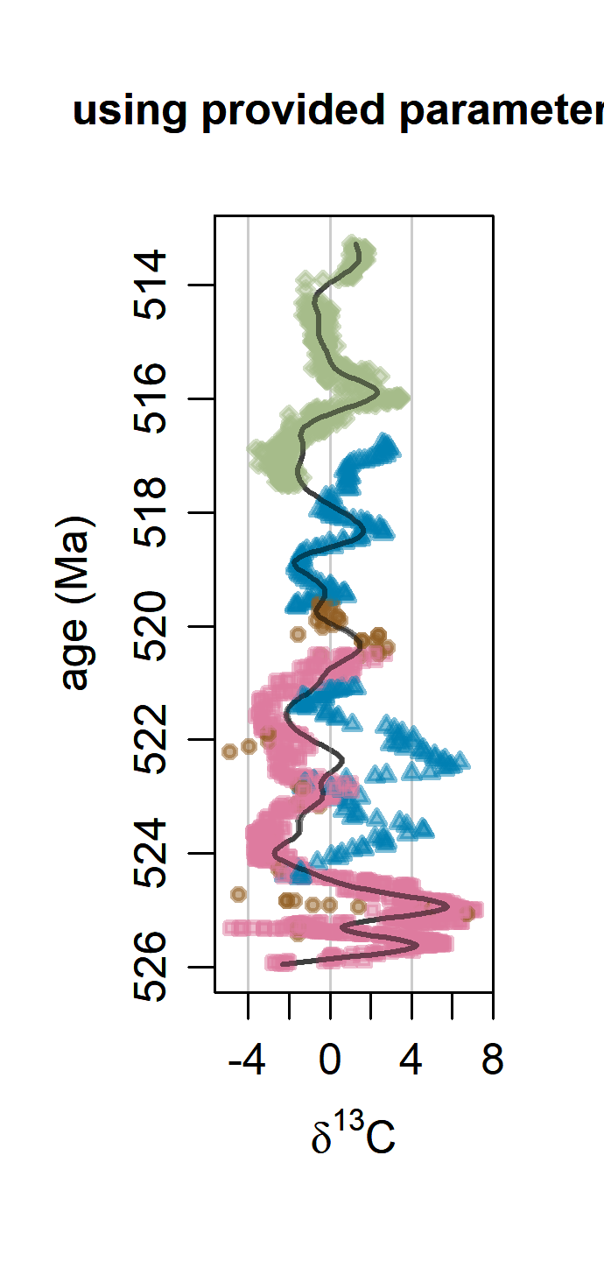
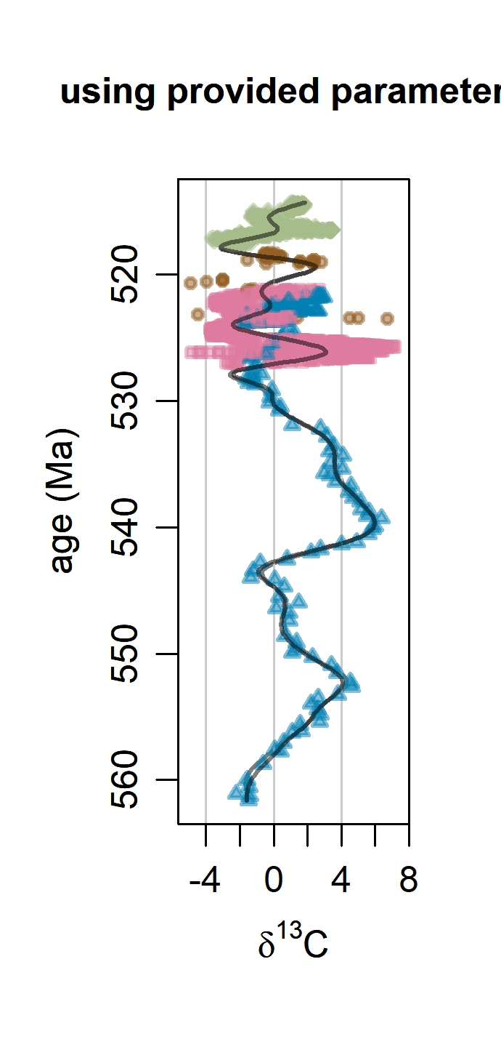
4
reference ages (α)
unconstrained sed. rates (γ)
astronomically constrained sed. rates (γ)
(c)
uncomformities
(a)
(b)
(c)
Sukharikha unconformity
Krasnoporog,
Sukharikha
Isaafen,
Amouslek,
Tifnout str.,
Tifnout (l.)
Lie de Vin (l.)
Oued Sdas
Ti., Su.
Talat n’Yssi
Lie de
Vin (u.)
Igoudine (l.)
Lie de Vin (m.)
Igoudine (u.)
range of (c)
(d)
site-specific multipliers (ζ)
(e)
uncomformities (δ)
(f)
random alignments from prior
Oued Sdas,
Talat n’Yssi
Unconformity between theSukharikha
and Krasnoporog formations.
(a)
reference ages (α)
Oued Sdas
Talat n’Yssi
Tiout, Sukharikha
(b)
unconstrained sed. rates (γ)
Isaafen, Amouslek, Tifnout stromatolite,
Tifnout (l.)
Krasnoporog, Sukharikha
(c)
astronomically constrained sed. rates (γ)
astronomically constrained sed. rates (γ)

Slide 3
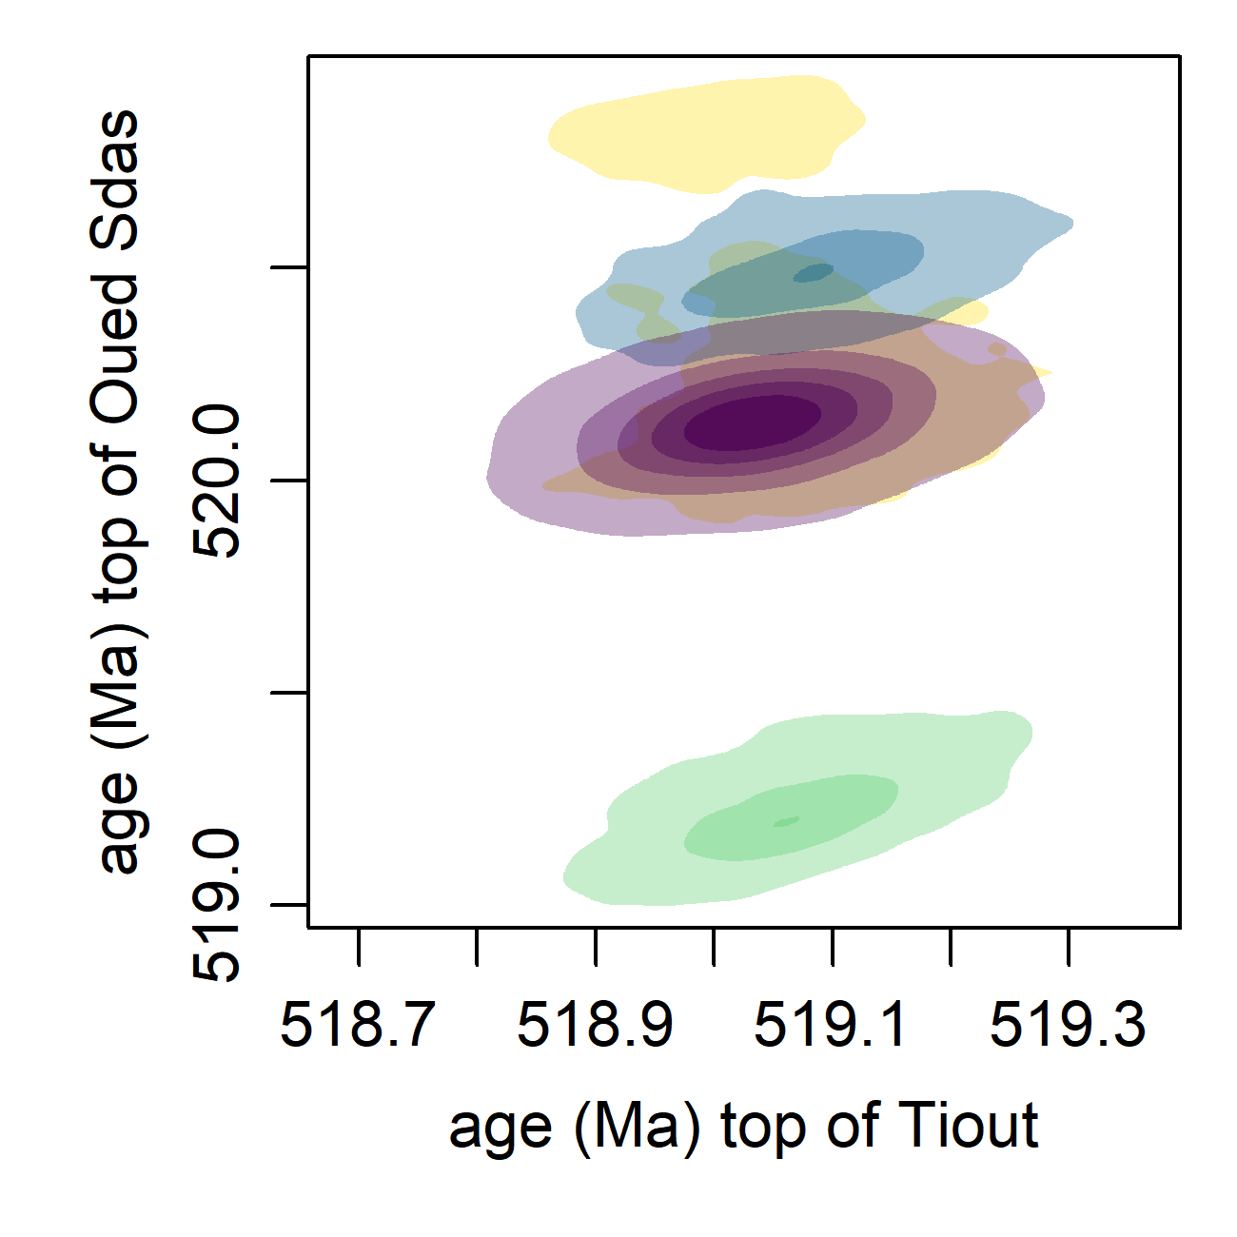
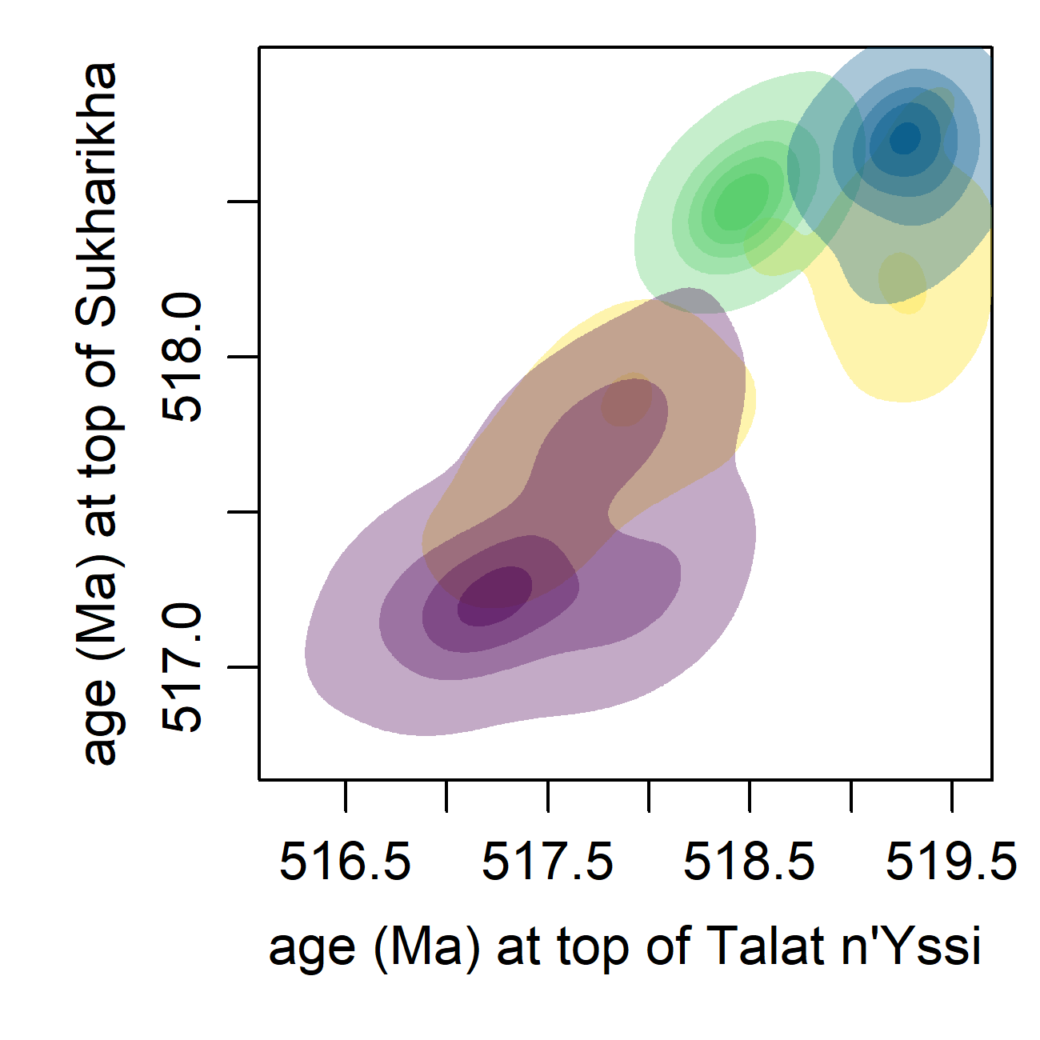
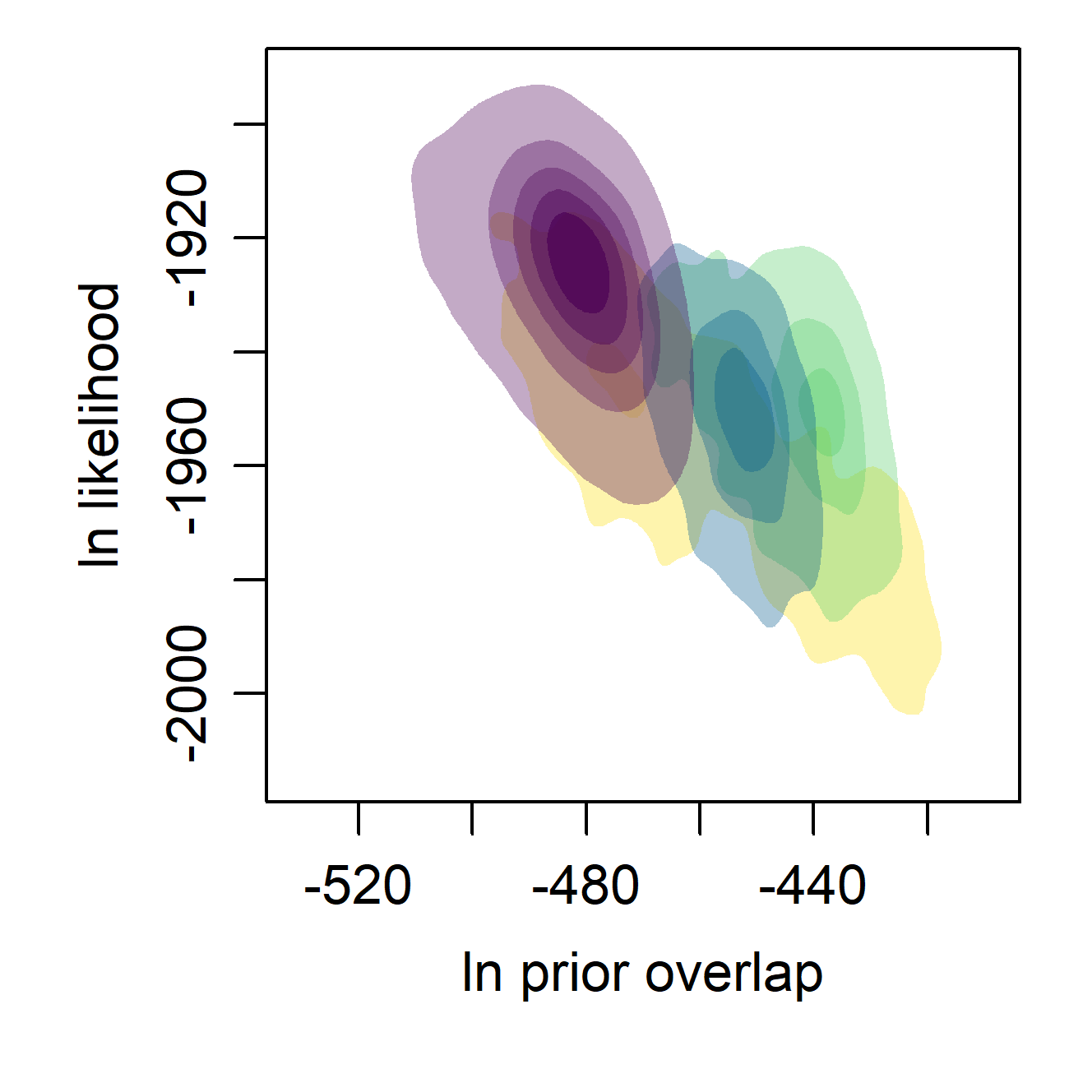
(a)
(b)
(c)
sample density
alignment 1
alignment 2
alignment 3
outlier samples

Slide 4
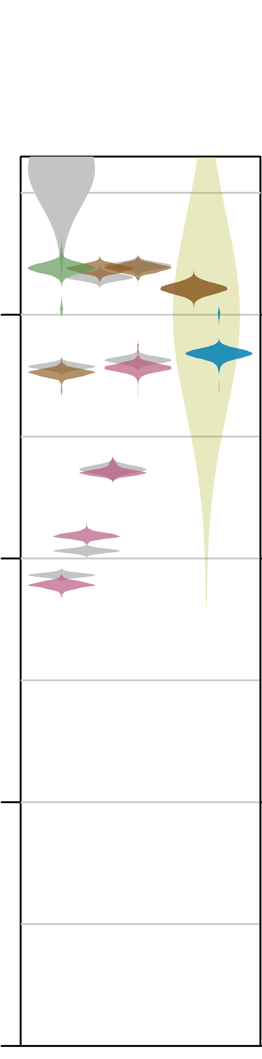
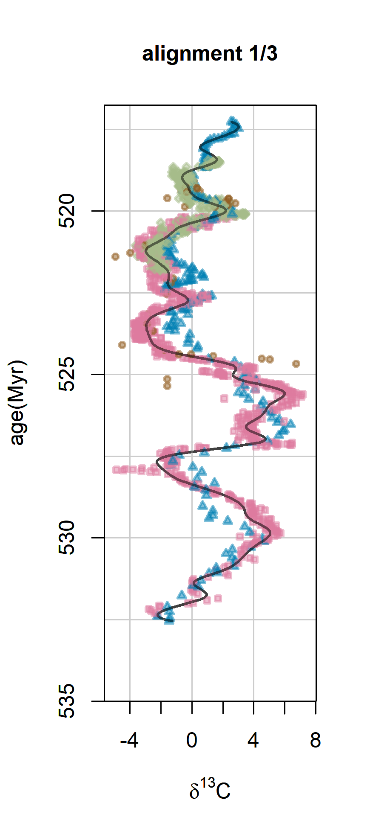
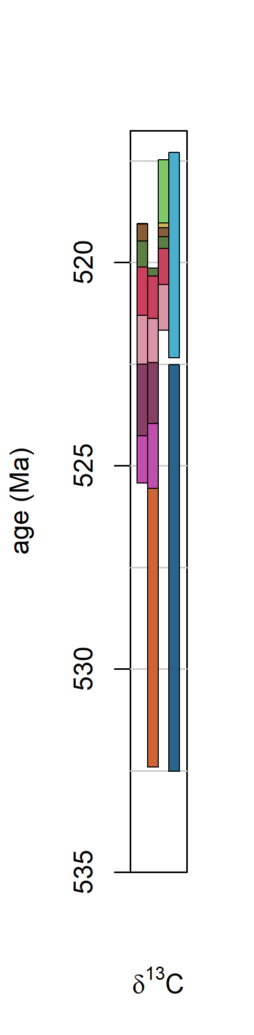
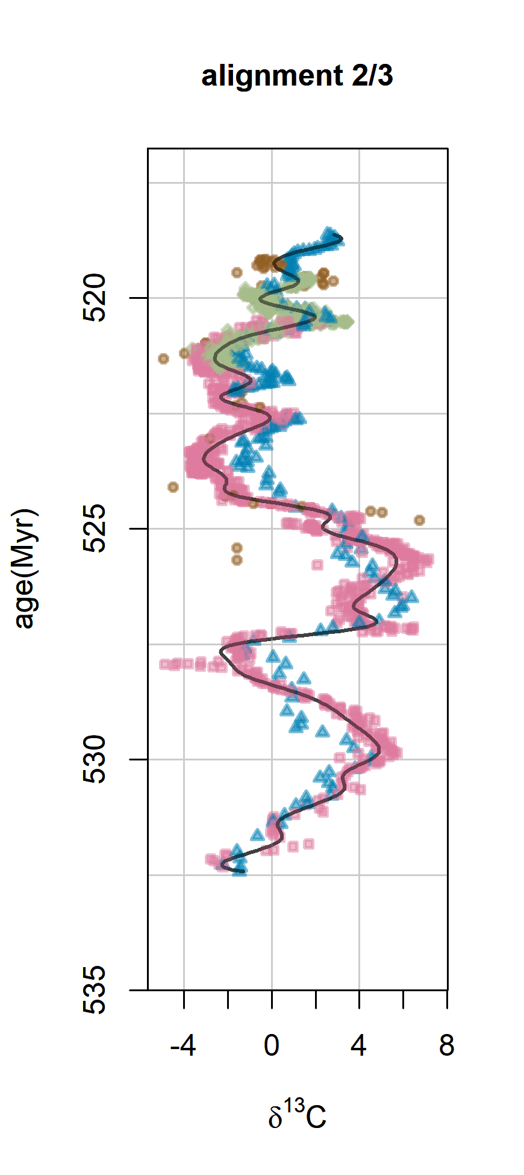
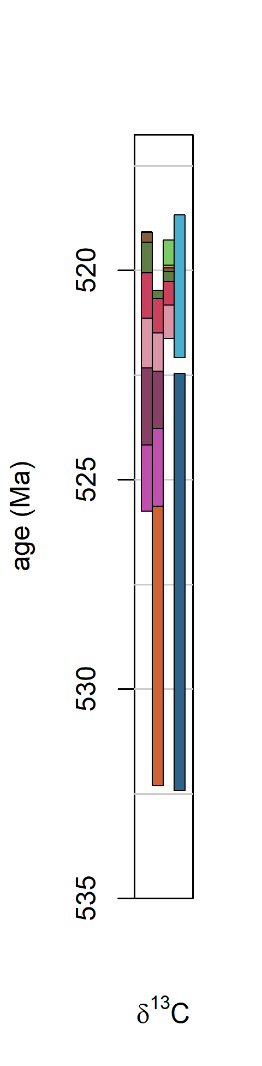
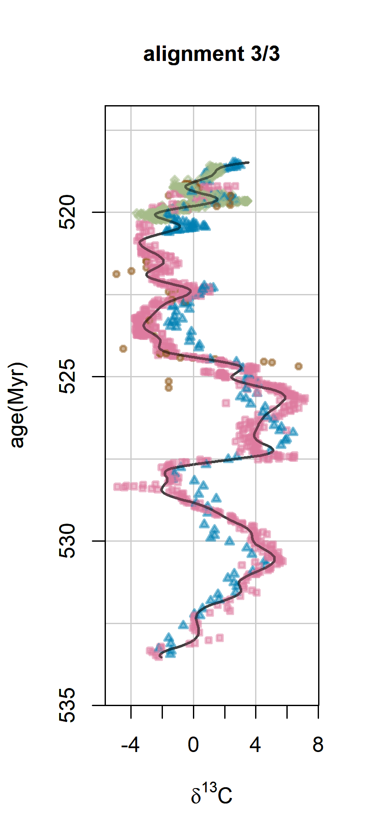
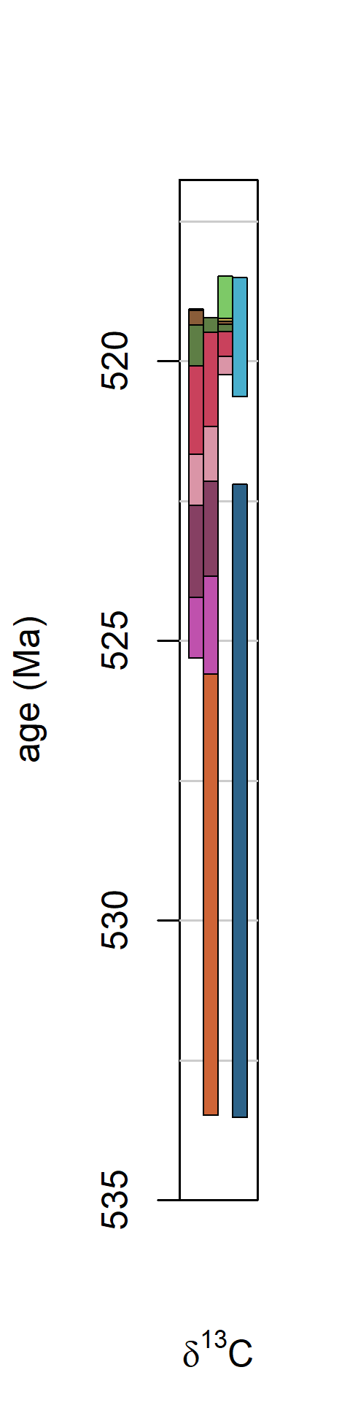

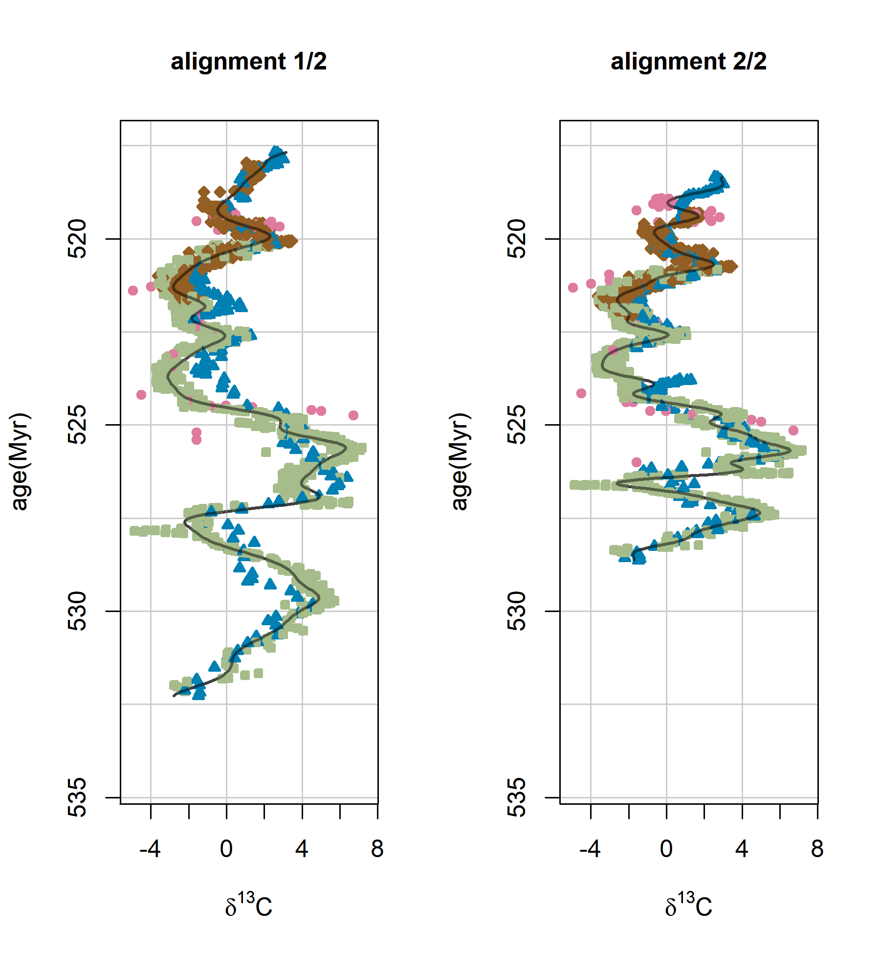
5
(a)
alignment 1
93% of samples
(b)
alignment 2
2.8% of samples
(c)
alignment 3
2.6% of samples
(d)
inferred ages
Ti₂
Ti₃
Ta₁
Ti tril.
Ti₁
Ou₄
Si
tril.
Ou₃
Ou₂
age (Ma)
Ou₁
radiometric dates
trilobite
appearances
Posterior density (coloured) and density of radiometric dates (grey) or prior (faint yellow)
legend:
Tiout
Oued Sdas
Talat n’Yssi
Sukharikha

Slide 5
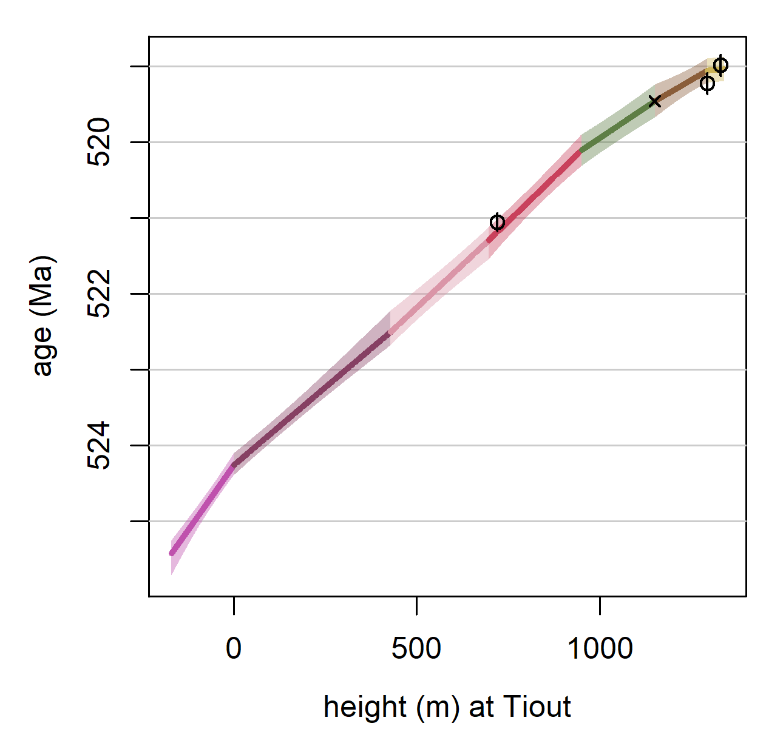
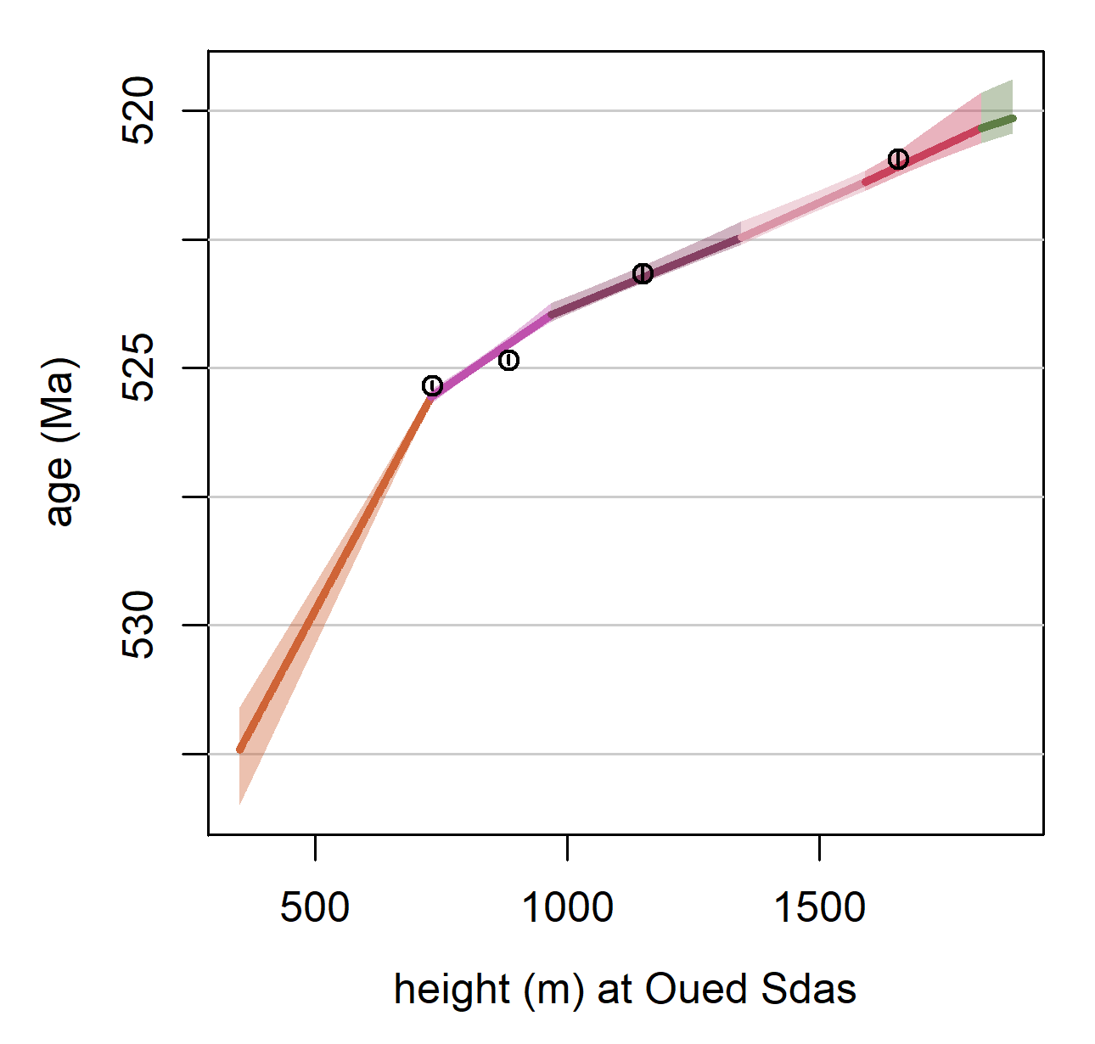
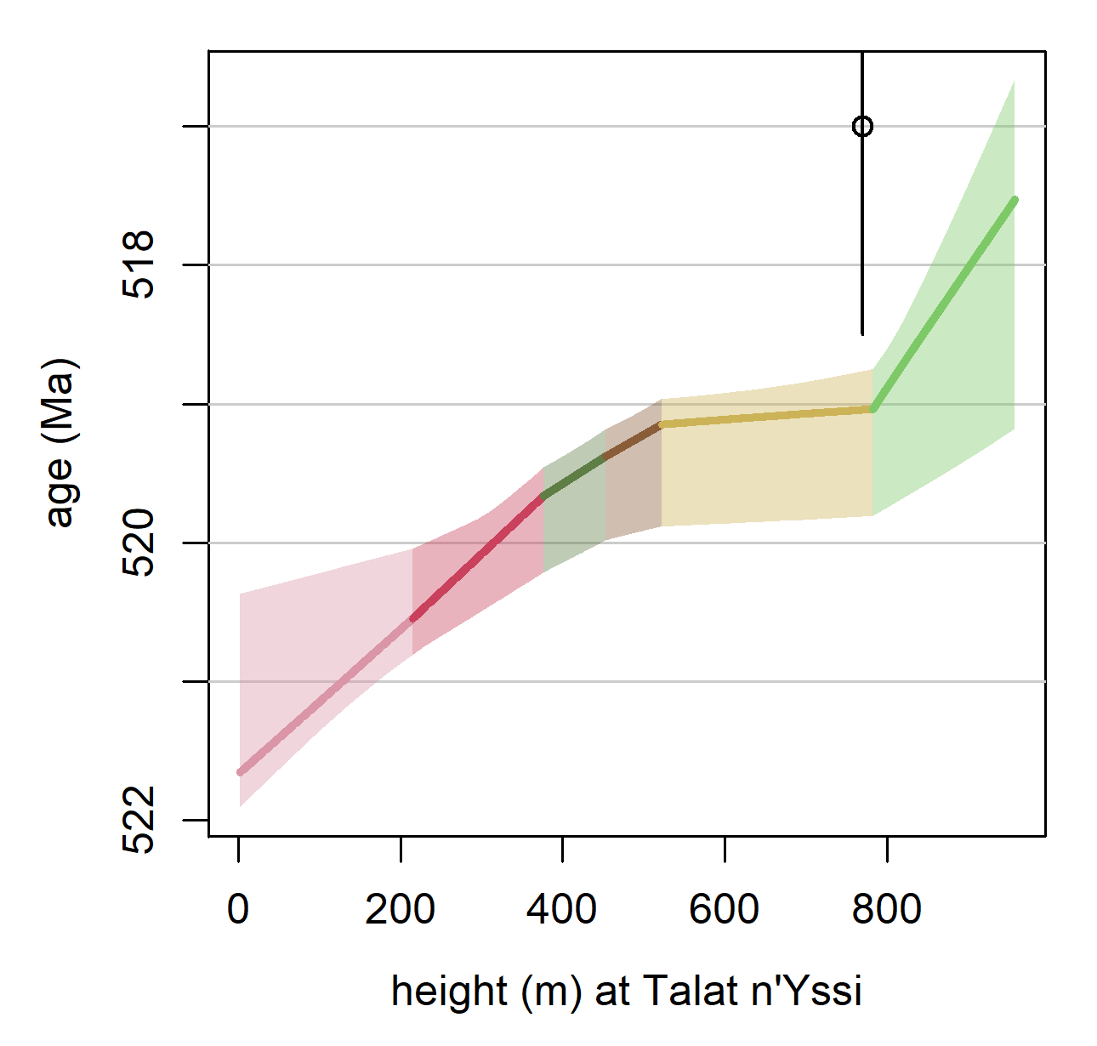
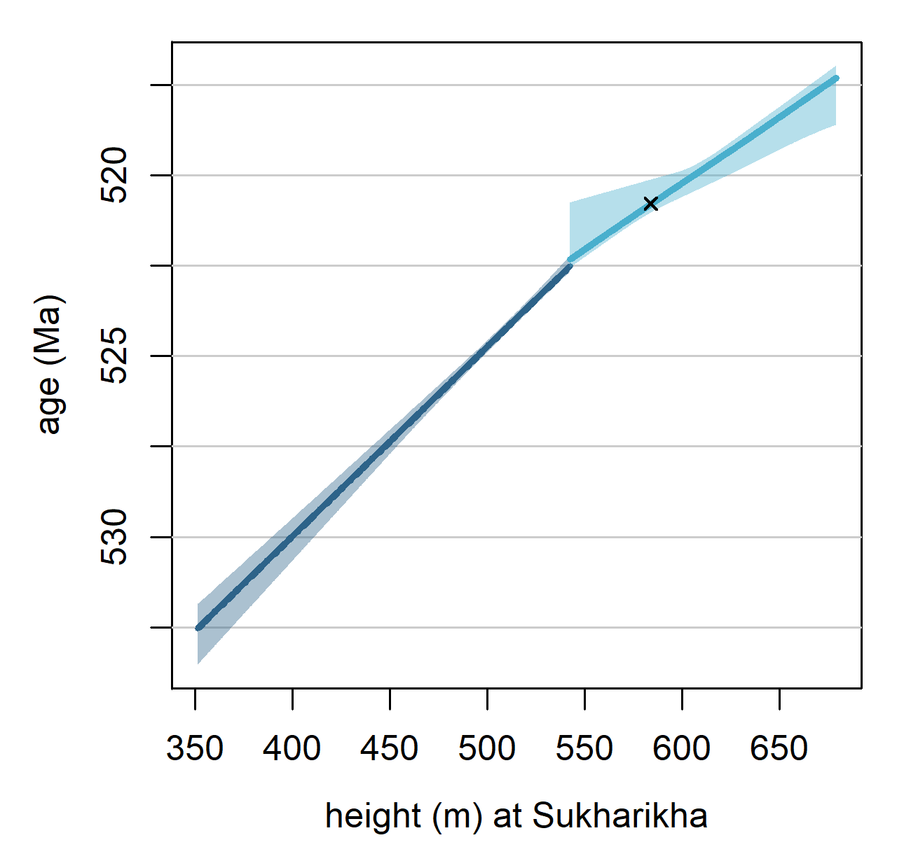
6
(a)
(b)
Tiout
Oued Sdas
(c)
(d)
Talat n’Yssi
Sukharikha

Slide 6
Appendix B

Slide 7
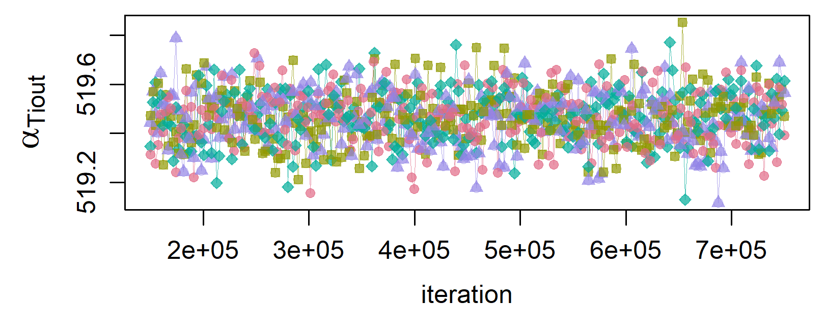
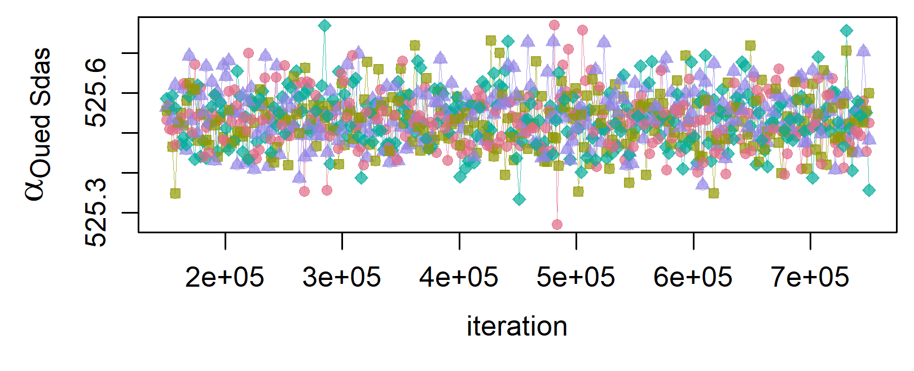
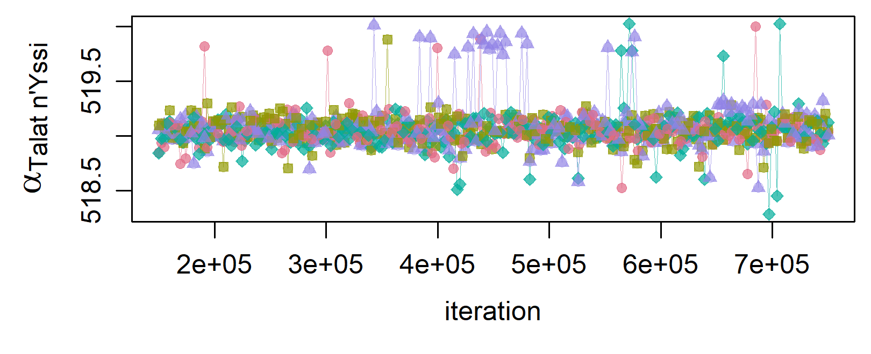
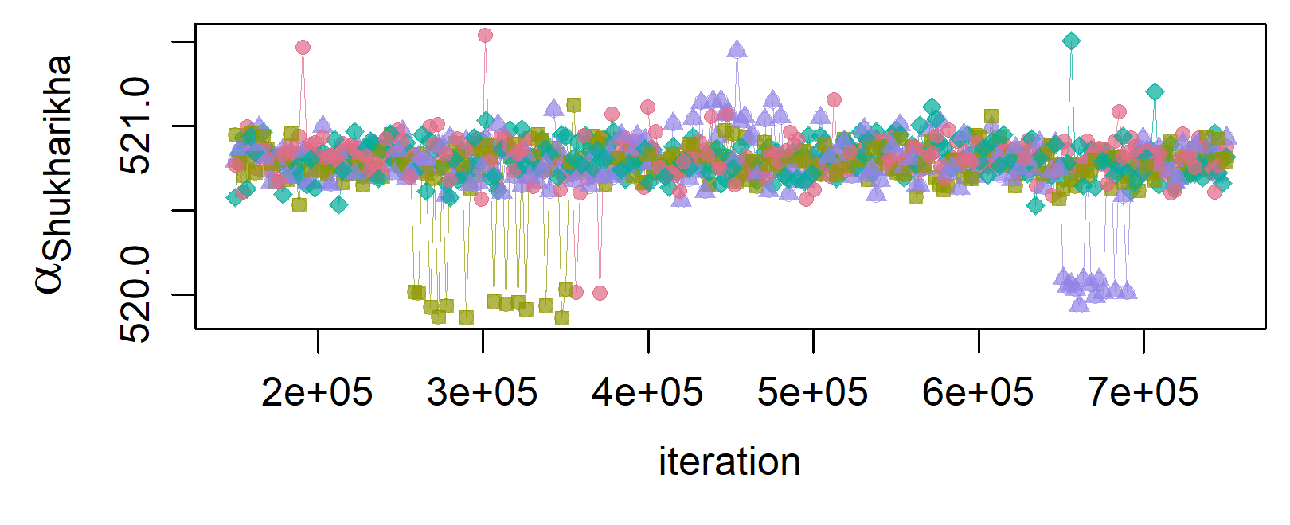
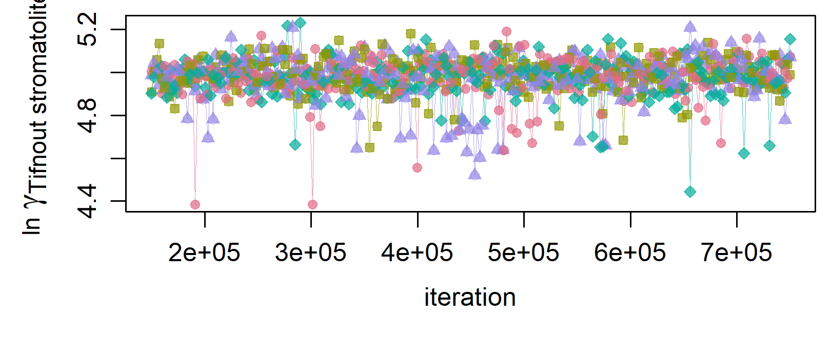
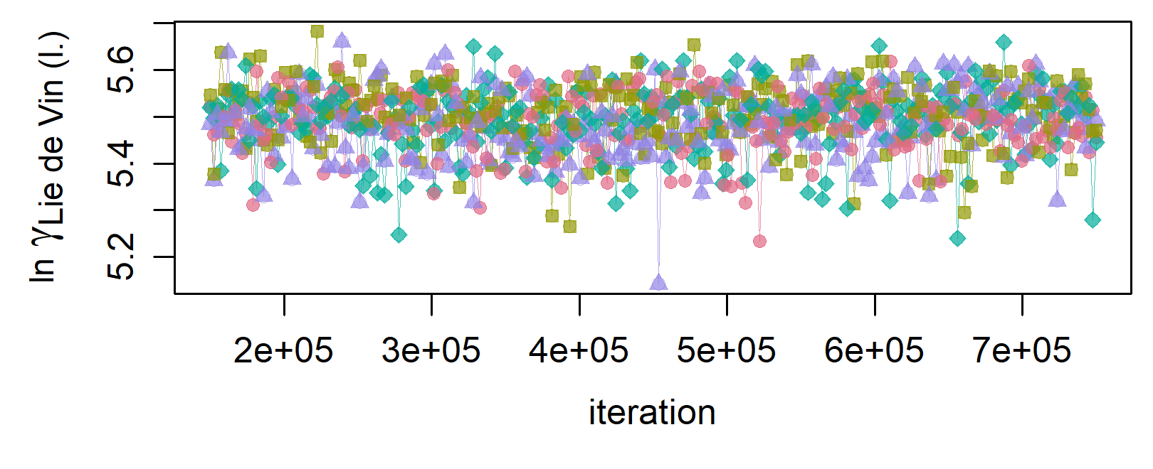
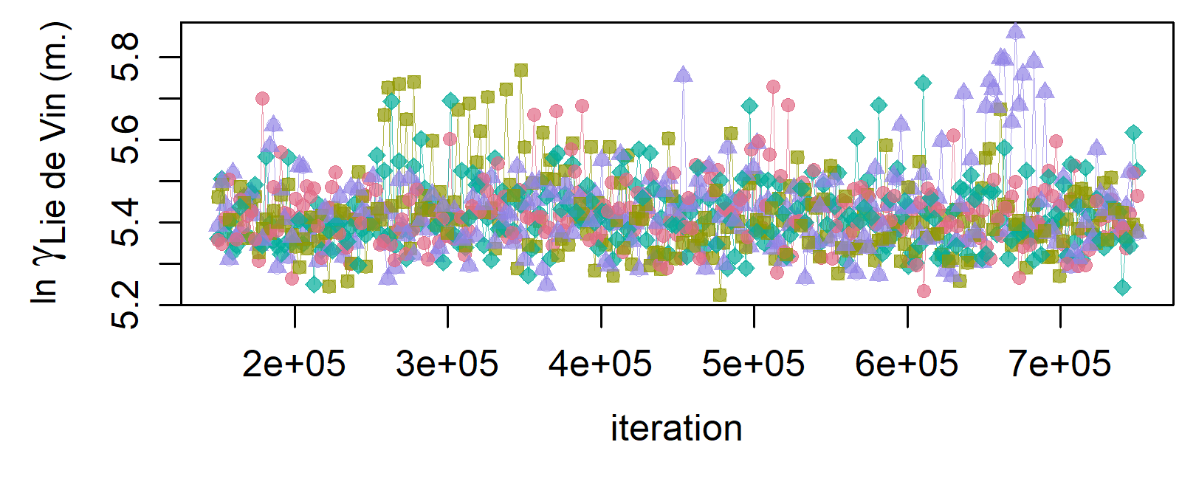
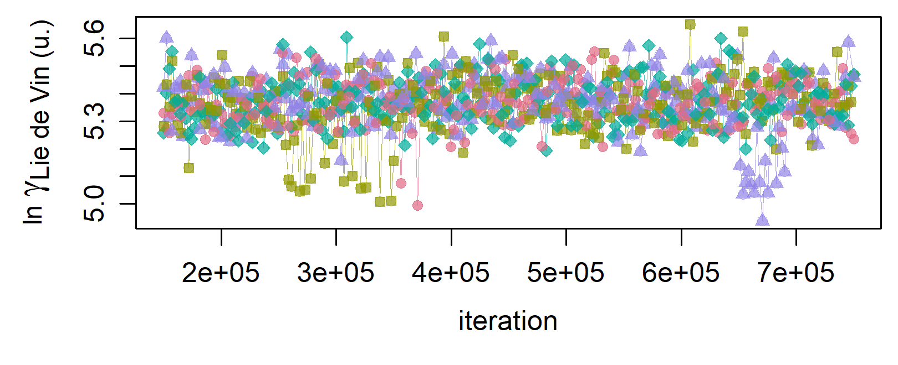
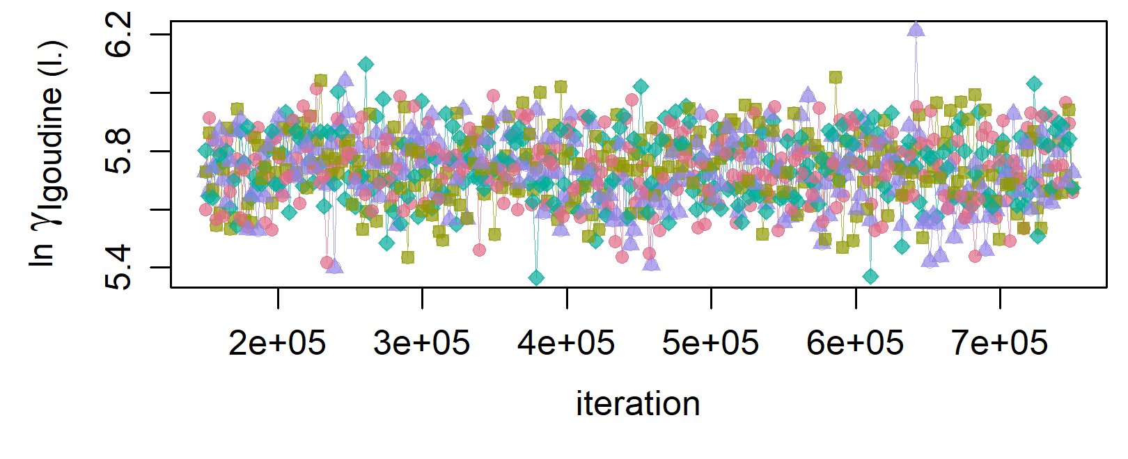
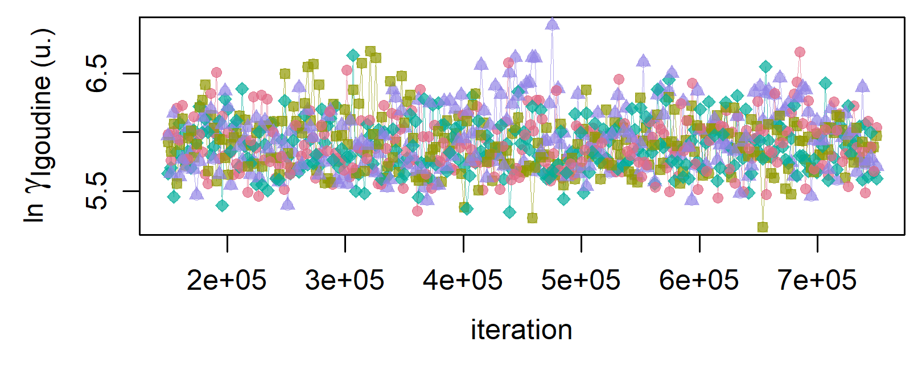
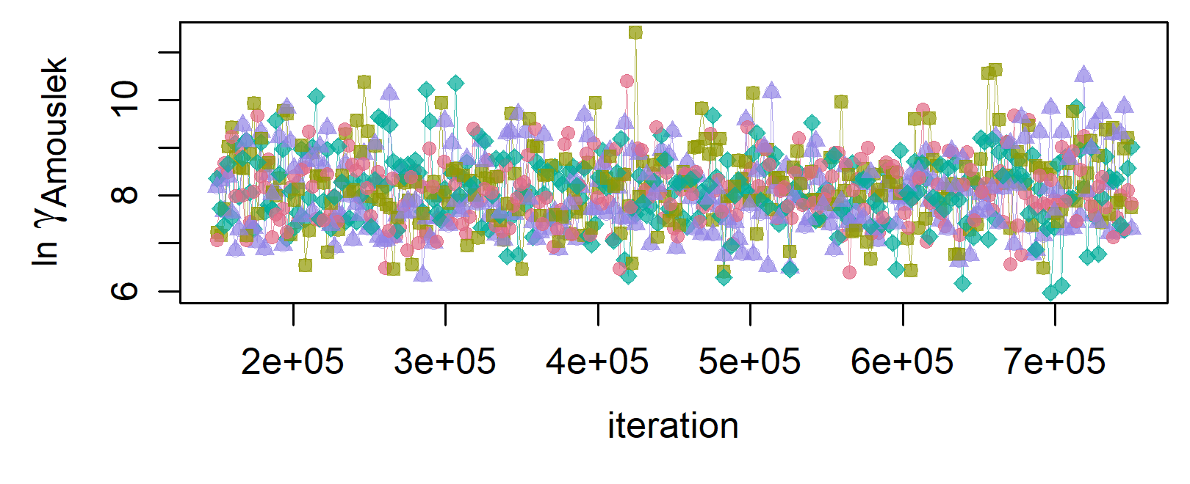
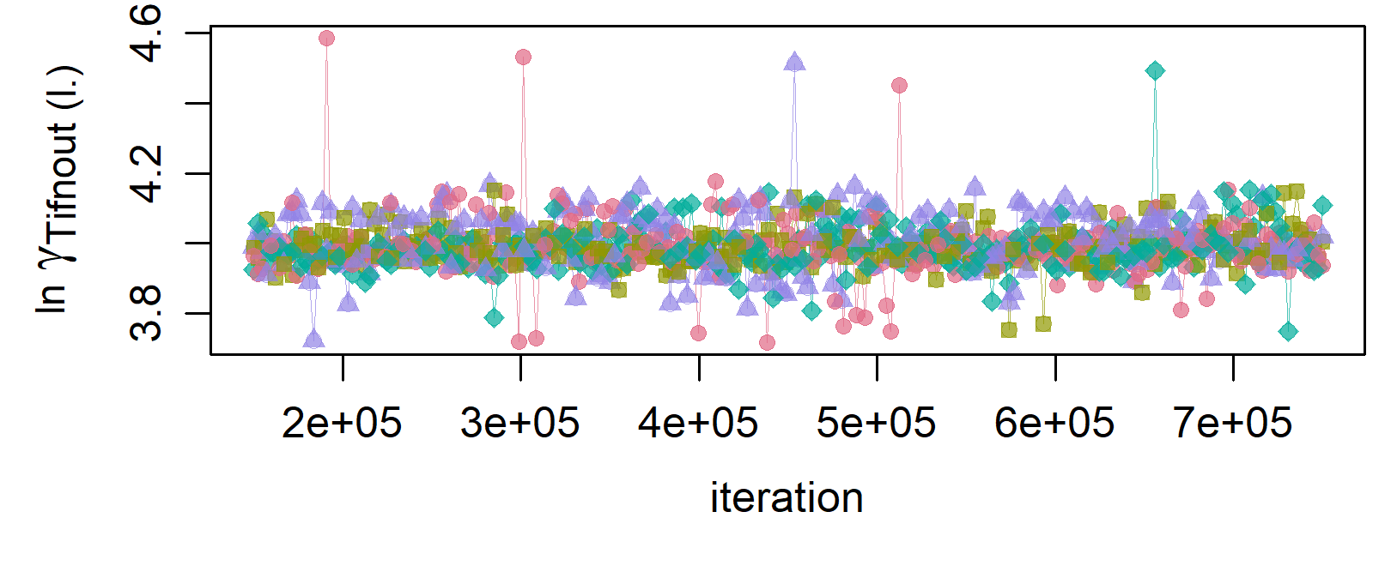
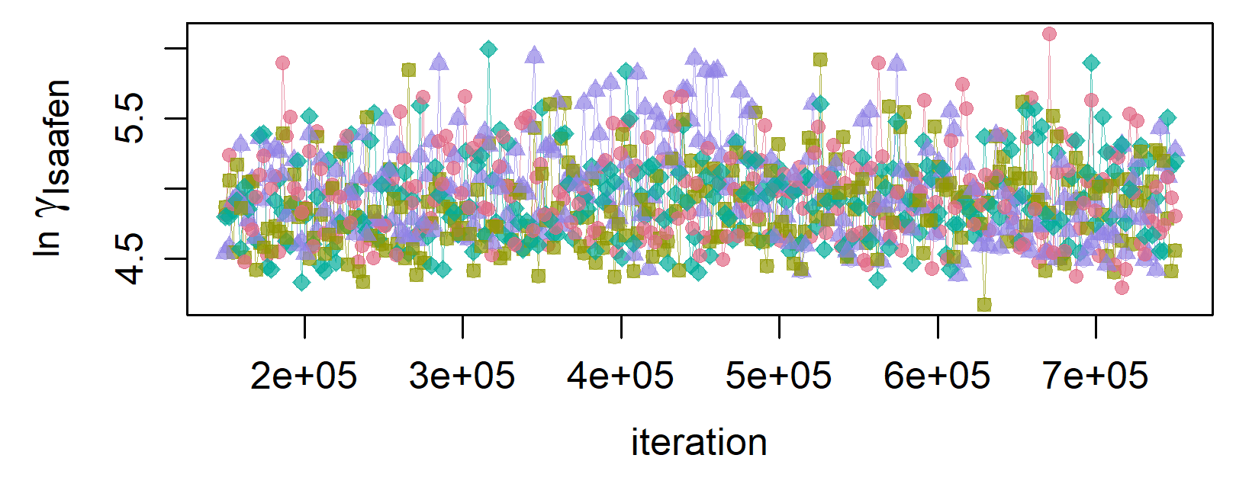
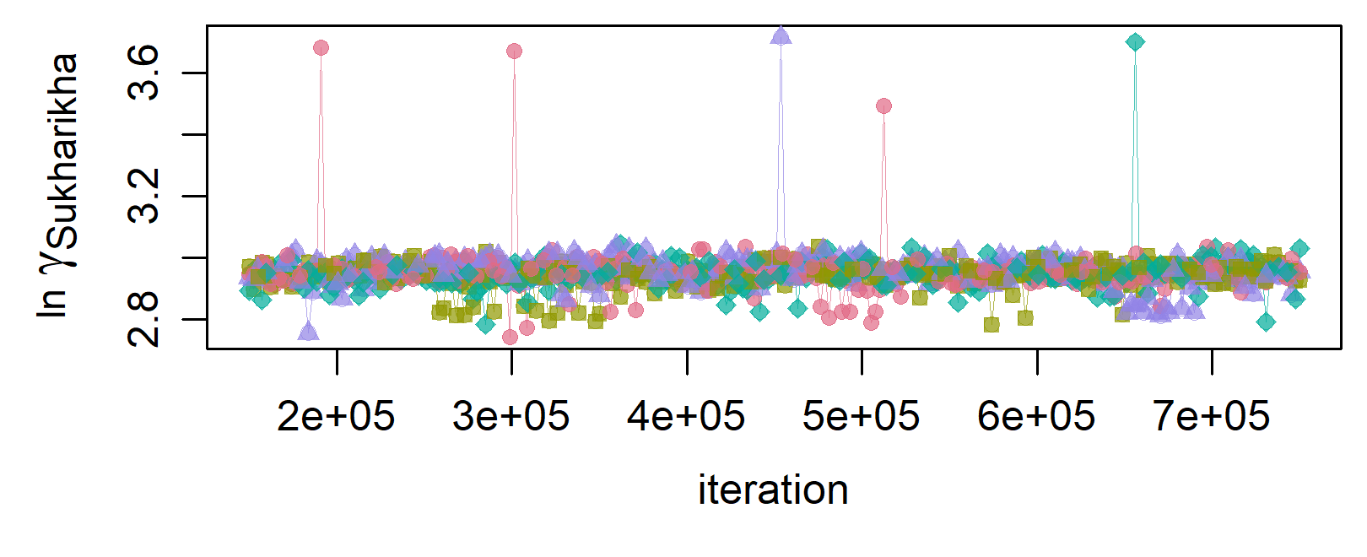
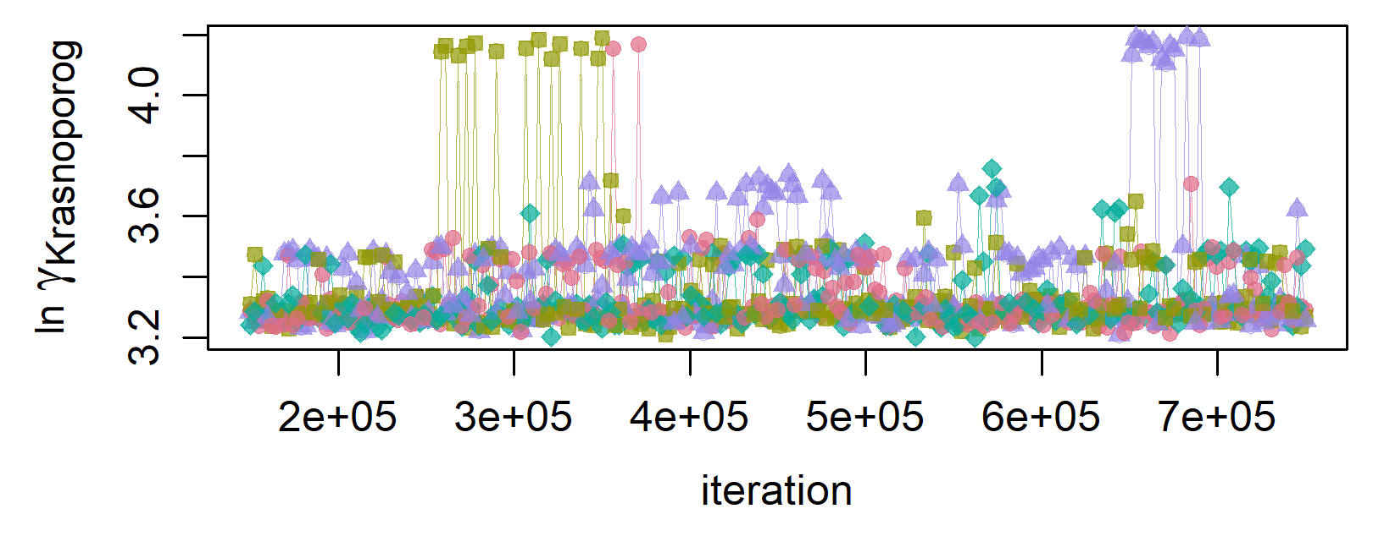
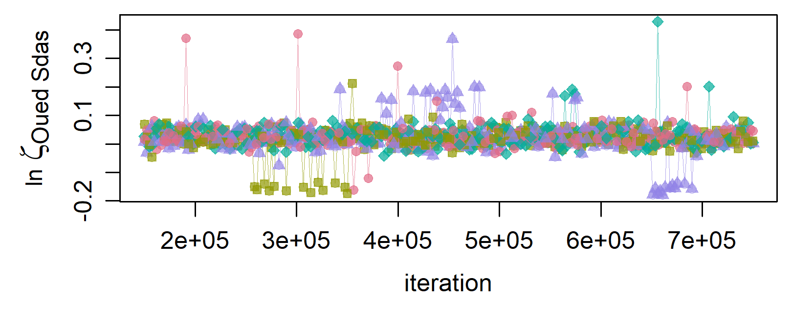
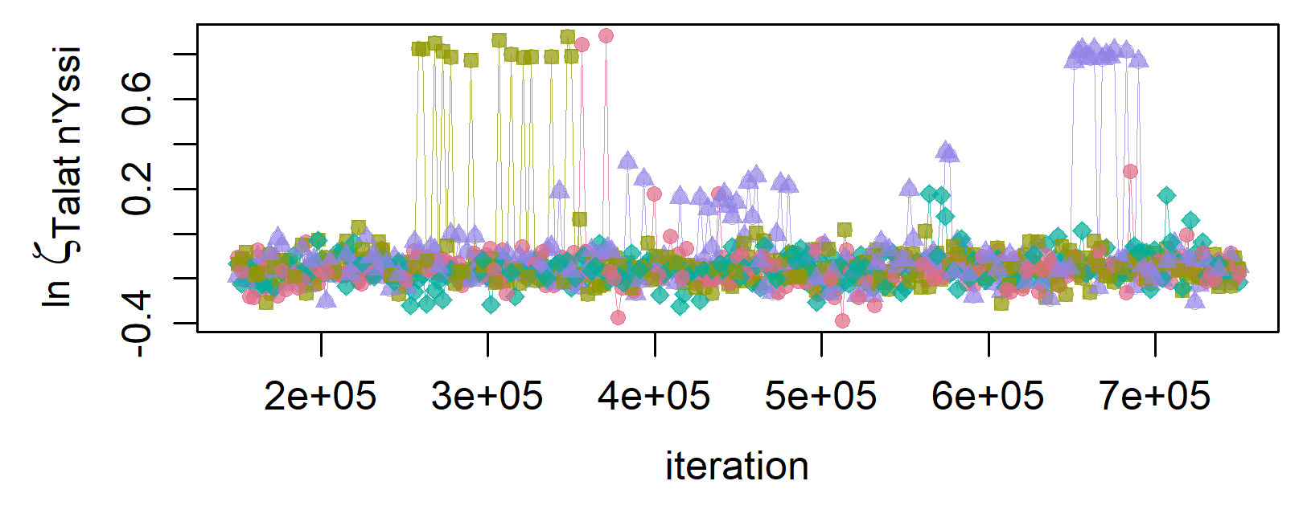
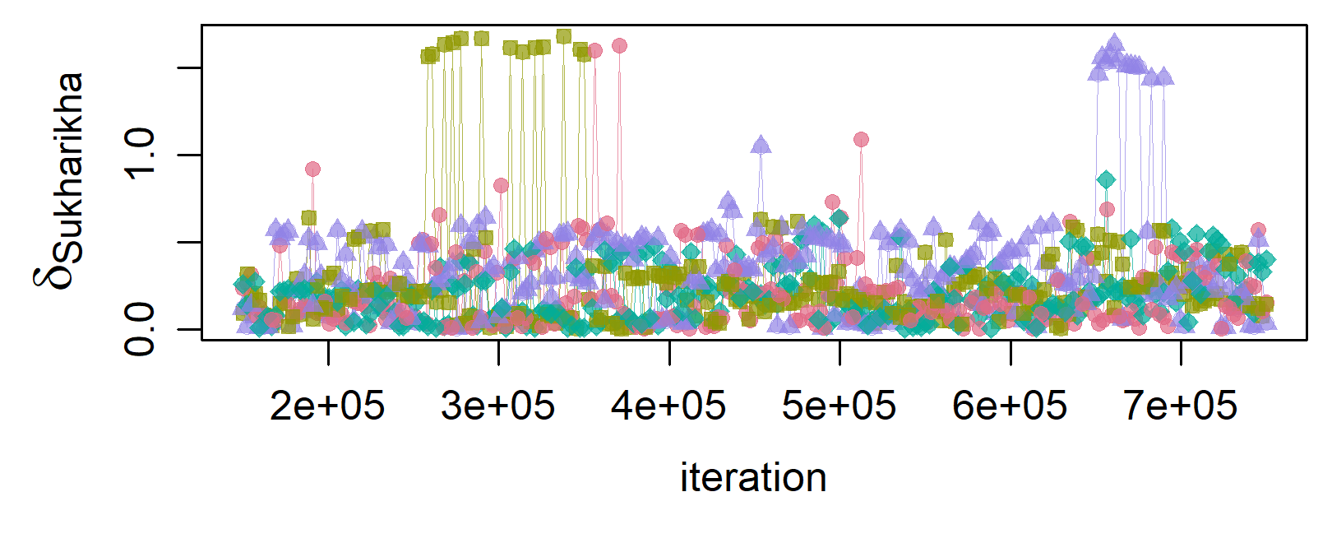
B1

Slide 8
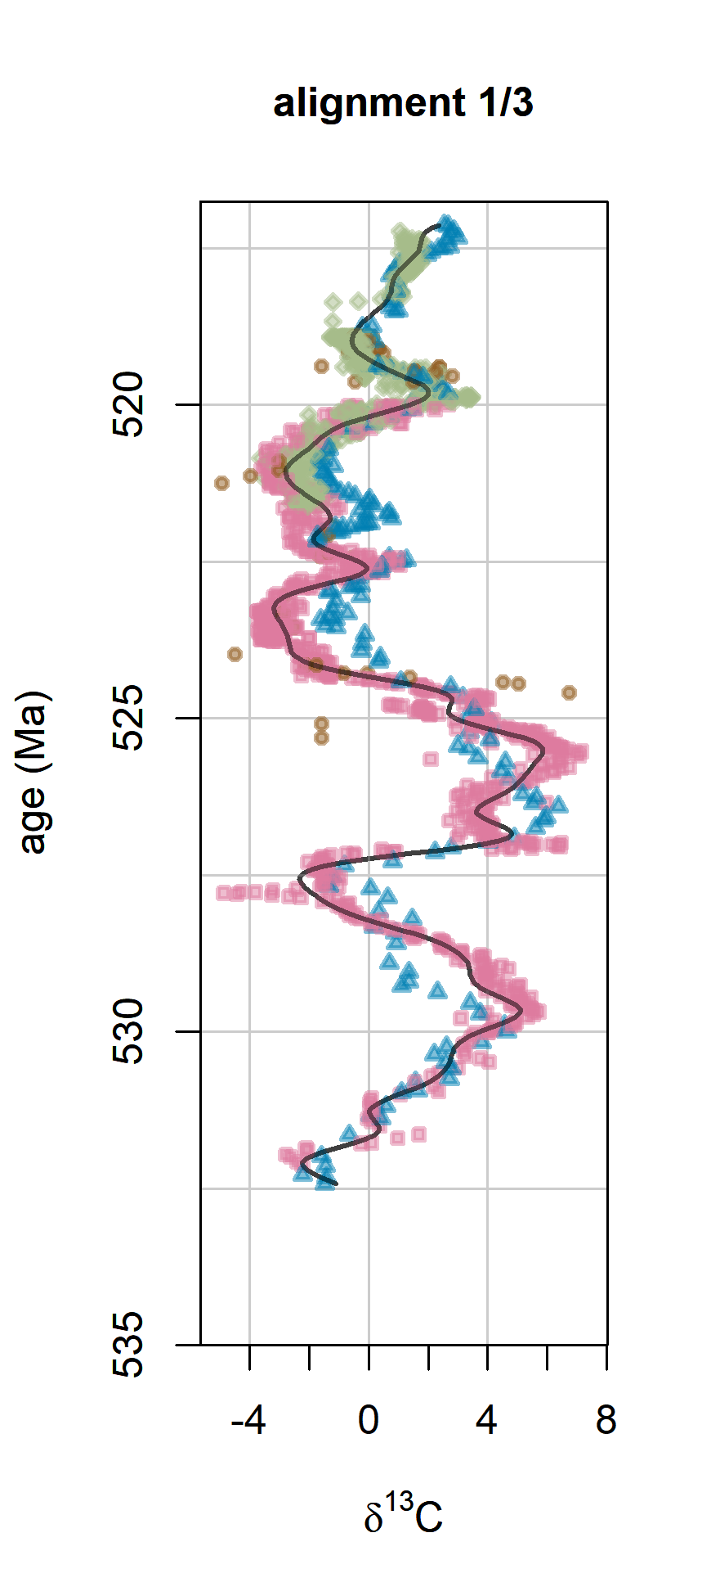
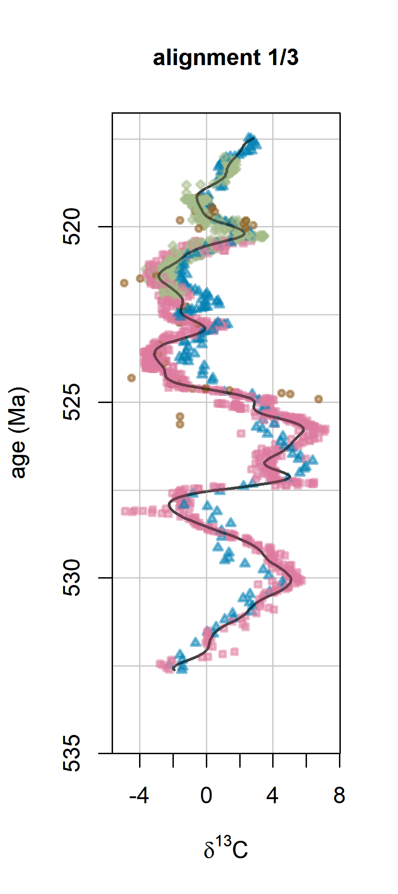
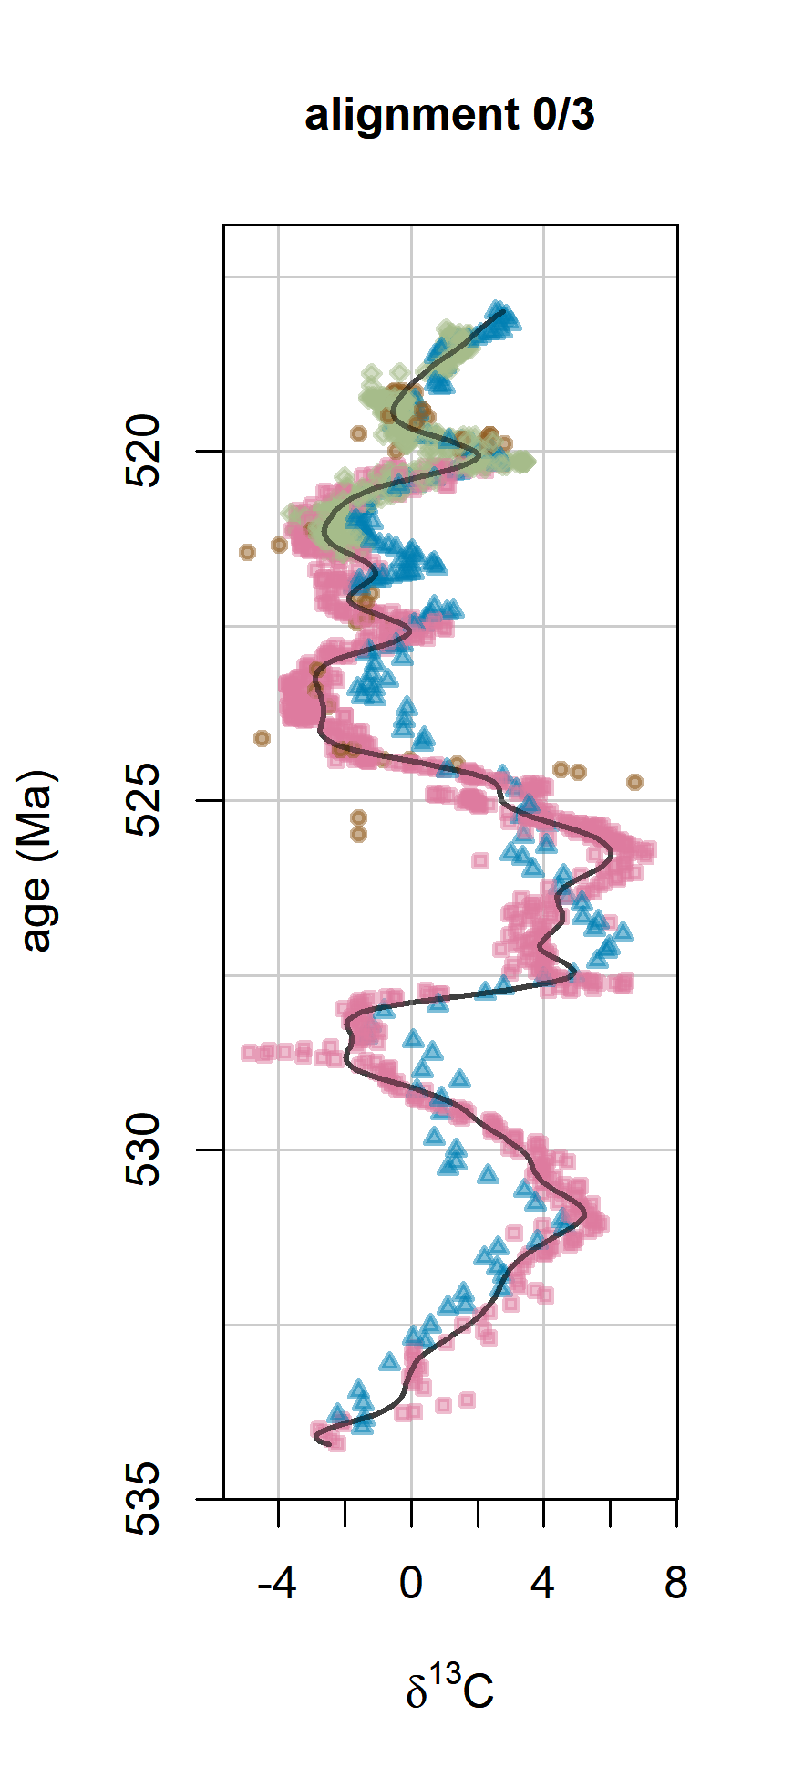
B3
(a)
(b)
alignment 1
sample 2
(c)
alignment 1
sample 3
(d)
alignment 1
sample 1 as in Fig. 5a
outlier sample not
assigned to any cluster
legend:
Tiout
Oued Sdas
Talat n’Yssi
Sukharikha

Slide 9
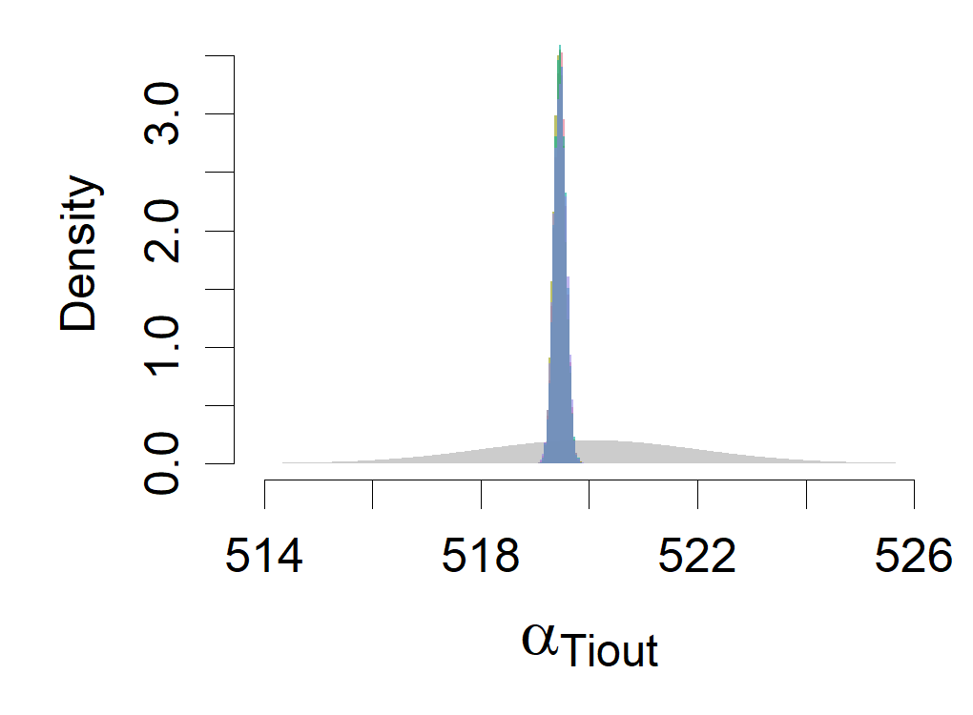


















B4
prior
run 1
run 2
run 3
run 4

Slide 10
Assessing convergence

Slide 11








B2
(a)
(b)
(c)
(d)
(e)
(f)
(g)
(h)
dates

Slide 12

Different visualisation of alignment1

Slide 13





Slide 14





Slide 15


Slide 16

87 %
3.6 %
3.4 %
1.8 %
1.2 %
1.1 %
0.7 %

Slide 17

0.6 %
0.2 %
< 0.1 %

Slide 18
Clustering with hdbscan and minPts = 1% of samples

Slide 19






93 %
2.8 %
unaligned
2.6 %
1.5 %

Slide 20



Slide 21



Slide 22


Slide 23



